Slide 1
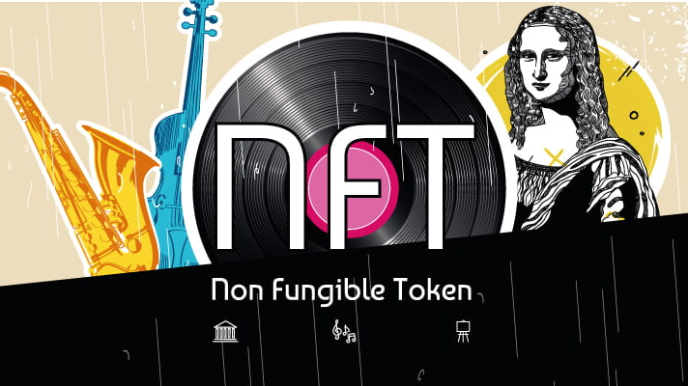
Non Fungible Fun
Presented by: Mike Rae Grace Ho
Muhammad Dosani
Mikhara Ramsing
Notes:
1-7 intro - Mikhara
8-11 jouney / API integration - Grace
12-15 smart contract / proof concept - Mike
16-17 summary and learning - Mo

Slide 2
What we’ll cover
NFT Concept - NonFungible Fun
The FinTooney Journey
Intro to the team
Utilising AI to alter images and create NFT Avatars
Toonify API Integration/ Python
Creation of token (TOON) and crowdsale
Auction and bid contract - Summary
Key learnings
Questions
Notes:
buy TOON through crowdsale
use TOON to buy NFTs

Slide 3
Non Fungible Fun - A digital avatar of the Fintech group
A digital collection of Non Fungible Collectibles of the Fintech 2021 group
Digital Avatar of classmate created as an NFT
Creation of a token Fintooneys (TOONS) to facilitate the sale on the Blockchain
Smart contracts deployed for Auction and bidding of the NFTs

Slide 4
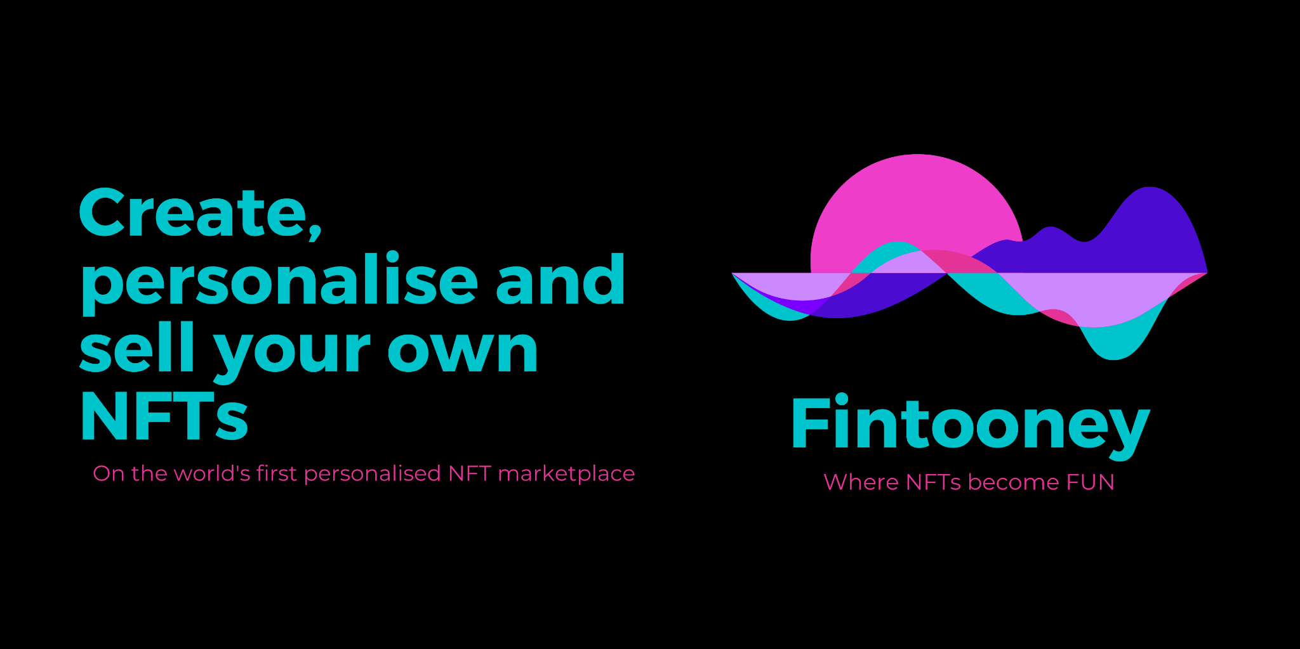
WORLD’s FIRST PERSONALISED
NFT MARKETPLACE
Toonify AI
IPFS Storage
Conversion of real images to selected toonify avatars
Decentralised storage via pinata to allow for URI connection in contracts and code

Slide 5
NonFungible Fun
Team Intro

Slide 6

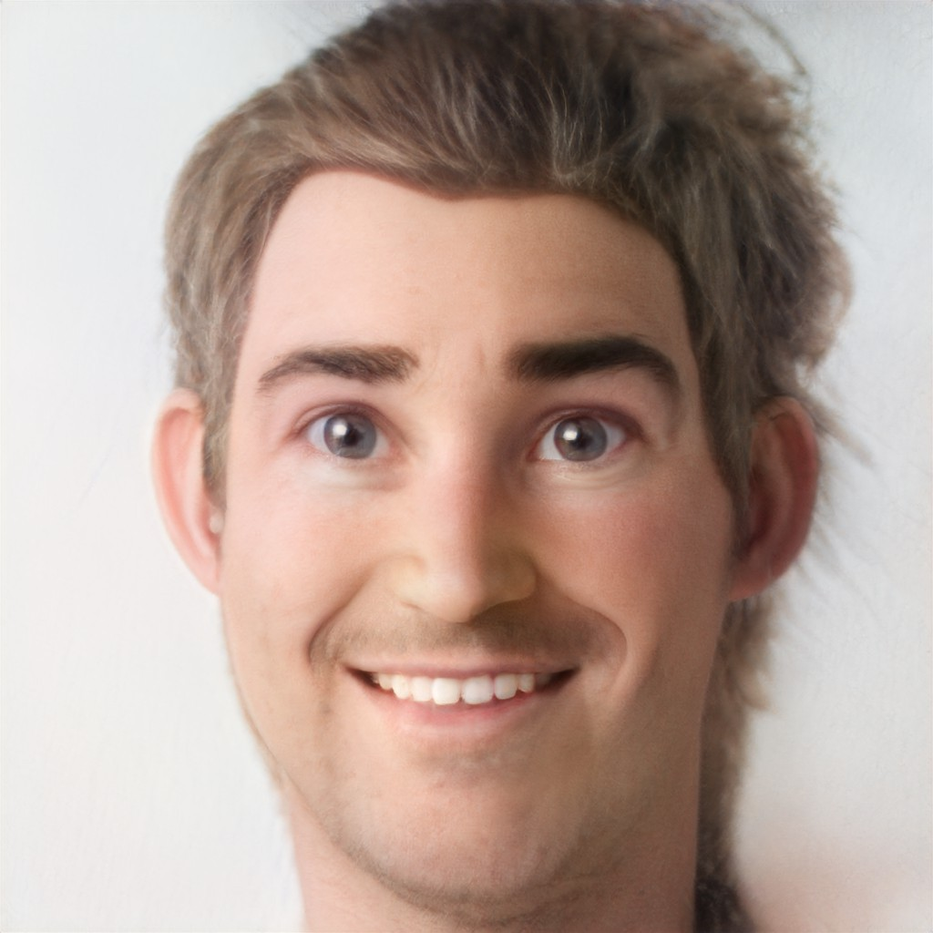
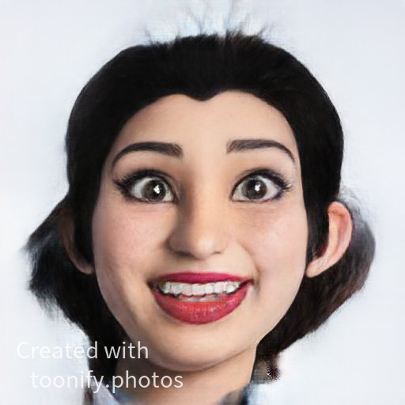
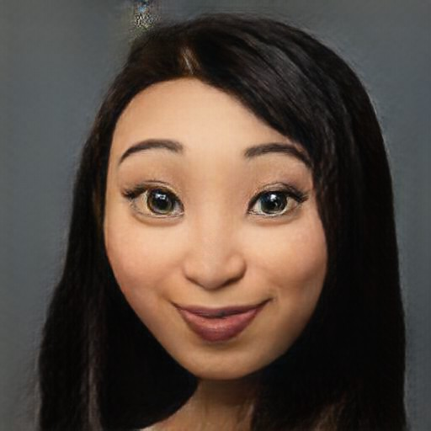
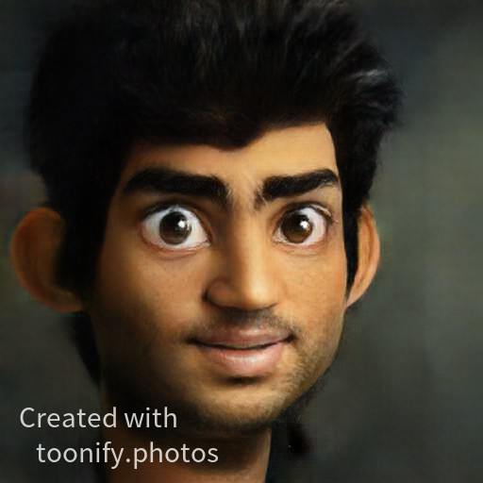
OUR TEAM
Week 1 FinTech Bootcamp
Mike
Rae
Bright eyed
sales
Mikhara Ramsing
Hopeful
Marketer
Grace
Ho
Optimistic
CFO
Muhammad Dosani
Visionary
Evangelist

Slide 7
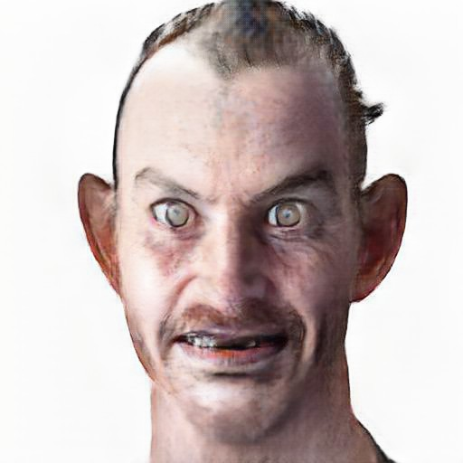
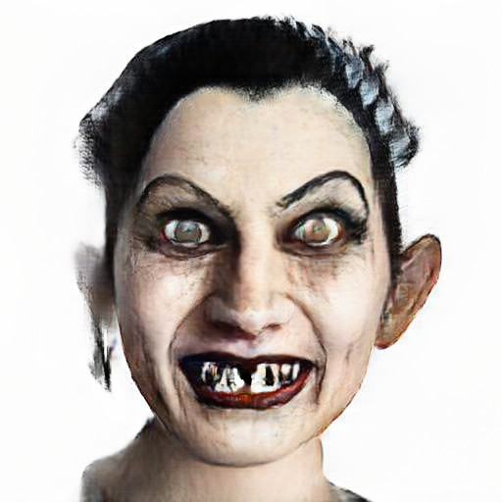
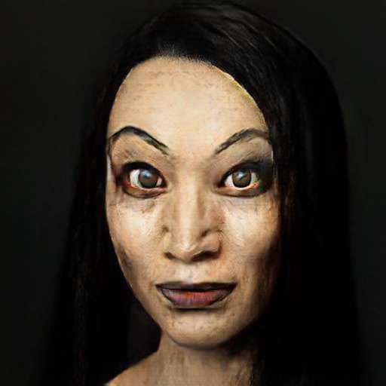
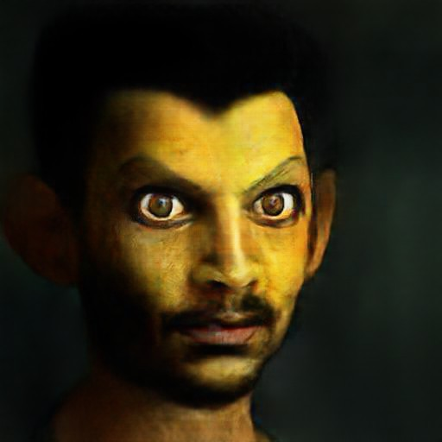
OUR TEAM
...An intense 24 weeks later
Mike
Rae
Pro
Developer
Mikhara Ramsing
Pro
Developer
Grace
Ho
Pro
Developer
Muhammad Dosani
Pro
Developer
Notes:
At the end of the bootcamp we took an after-shot

Slide 8
The FinTooney Journey
User Journey
Load image onto portal
Personalise image (AI / ML or artist)
Front End Auction Site
Purchase TOON* with ETH
Purchase NFT with TOON*
You own your personalised NFT!
NFT Created
API call to Toonify (RapidAPI / Python code integration)
IPFS filestore (via Pinata)
Web or Python portal
ERC721 Token
ERC20 Token
Bid & auction process
Ownership transferred
Architecture
Solidity - Smart Contracts & auction
Notes:
8-11 Journey / API integration - Grace
The user journey is highlighted in the white box.
Anyone can load an image onto a web or python integrated portal.
We used Python to have the image rendered using ML into an avatar image.
Our python code then sent the image to be stored on IPFS via Pinata.
We created a TOON token with which we intended the ERC 721 NFTs to be purchased via an auction site.

Slide 9
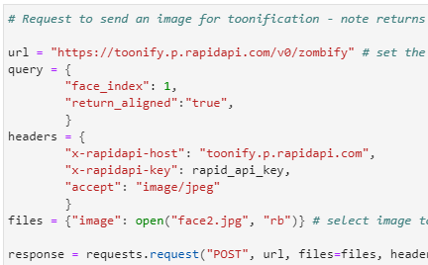
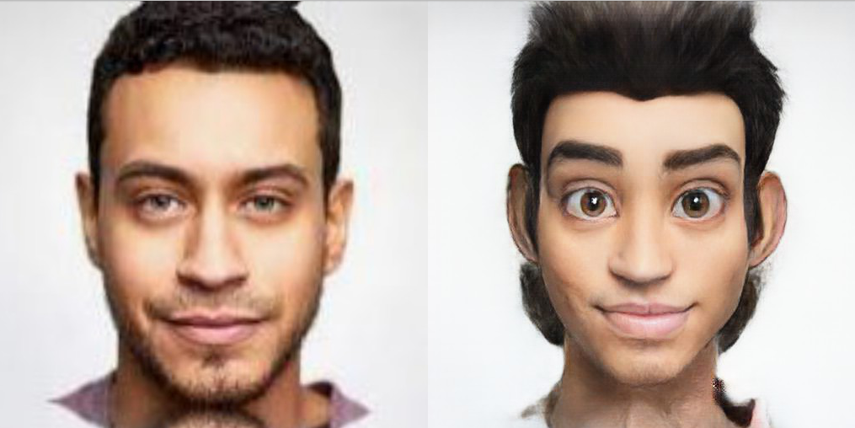
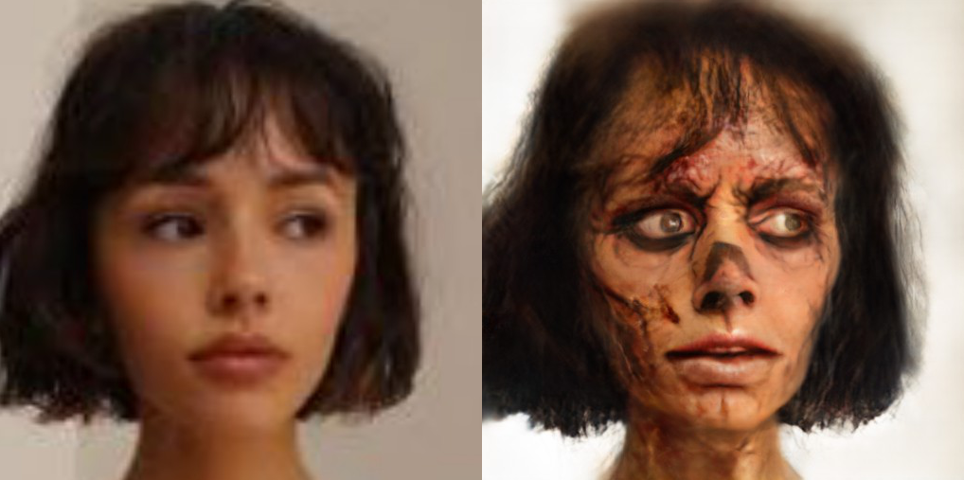

TOONIFY API Integration/ Python
API built out from RapidAPI using python (via Jupyter Notebook)
Initial API call returned image in bytes which required additional code to convert back to JPEG format
Test image #1
Test image #2
Notes:
8-11 journey / API integration - Grace

Slide 10
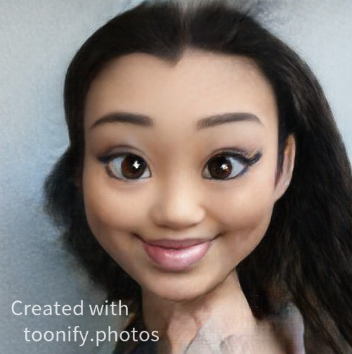
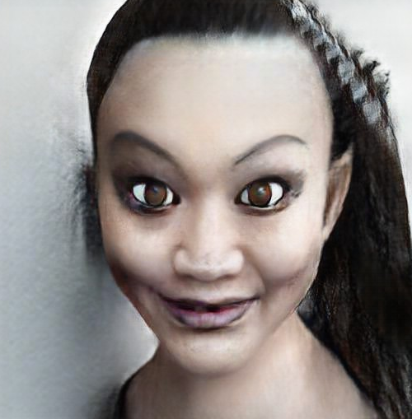
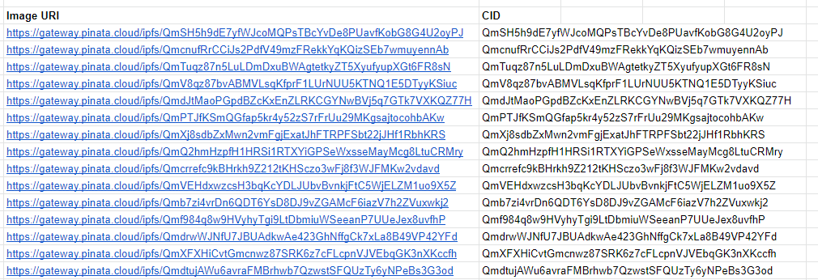
Utilising AI to alter images and create NFT Avatars
Toonify AI
IPFS Storage
Conversion of real images to selected toonify avatars
Decentralised storage via pinata to allow for URI connection in contracts and code
Notes:
8-12 journey / API integration - Grace

Slide 11
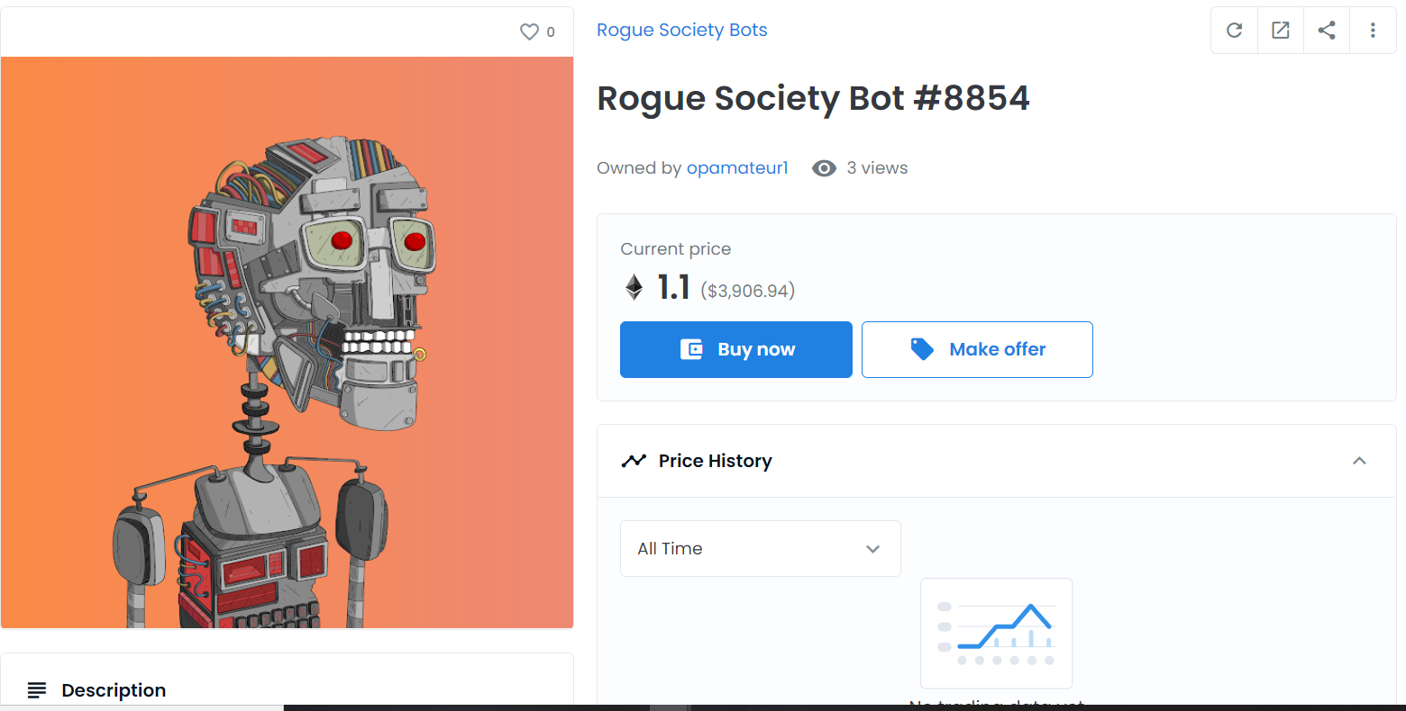
Utilising AI to alter images and create NFT Avatars
Toonify AI
IPFS Storage
Halloweenified CLAUDIA DONG
Conversion of real images to selected toonify avatars
Decentralised storage via pinata to allow for URI connection in contracts and code
Notes:
8-12 journey / API integration - Grace

Slide 12
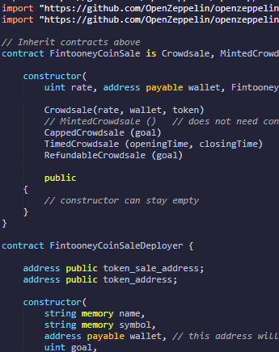
Creation of token and crowdsale
Token contract
Type: ERC20 token
Name: FintoonyCoin
Symbol: TOON
Crowd sale contract and deployment
Testing via;
Javascript VM (local)
Injected Web3
Ganache
Rinkeby Testnet
Solidity contract code example
Notes:
12-15 smart contract / proof concept - Mike
When we started we initially created a FinTooney Token and set up a crowdsale contract with the intent of using the token (TOON) as a requirement for the auctions but there is complexity getting a contract to run using a token vs ETH.
The code all runs and was tested on the local drive, Ganache and Rinkeby Testnet. So given more time would just need to add the additional code to require TOON token vs ETH.

Slide 13
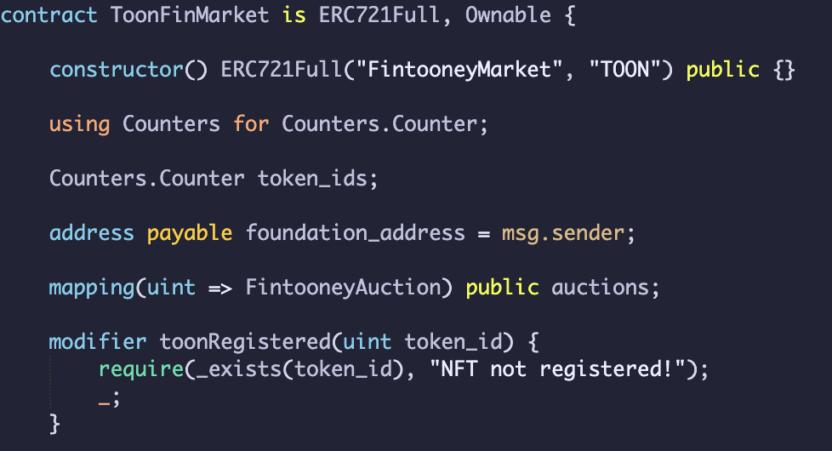
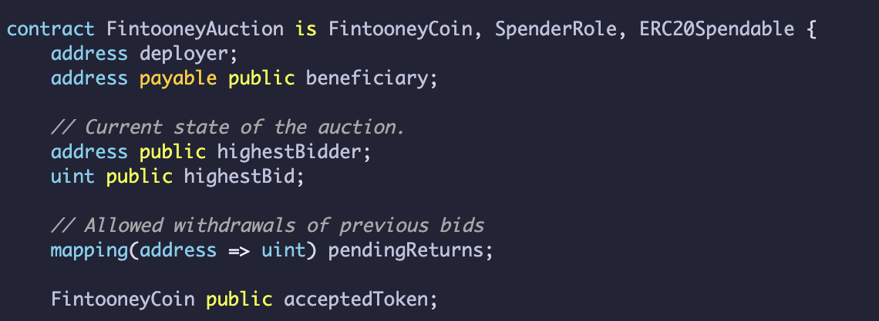
Auction and bid contract
Fintooney Auction Contract
Intended to set TOON as currency for auction but more complex than envisioned
Set up rules for Auction: bid, bid time, highest bidder, withdraw bid, auction end
Fintooney Market Contract
Intention: use ERC20 to buy ERC721
Intention: Called for msg balance of TOON
Auction held for each NFT
Notes:
For the Auction contract this was set up for the auction parameters and rules for example biding and refunds, we were trying to change the currency from ETH to TOON as a requirement here.
The Market contract uses the NFT auction contracts and creates the market allowing for multiple auctions and the associated rules.
The market contract is effectively the foundation of all the auctions.

Slide 14

Proof of concept
Notes:
Finally, we created a prototype on of what the FinTooney marketplace would look like on iPhone, front end, clicking through to NFT of choice then into the auction/ bid page.
The prototype was built using Figma.

Slide 15
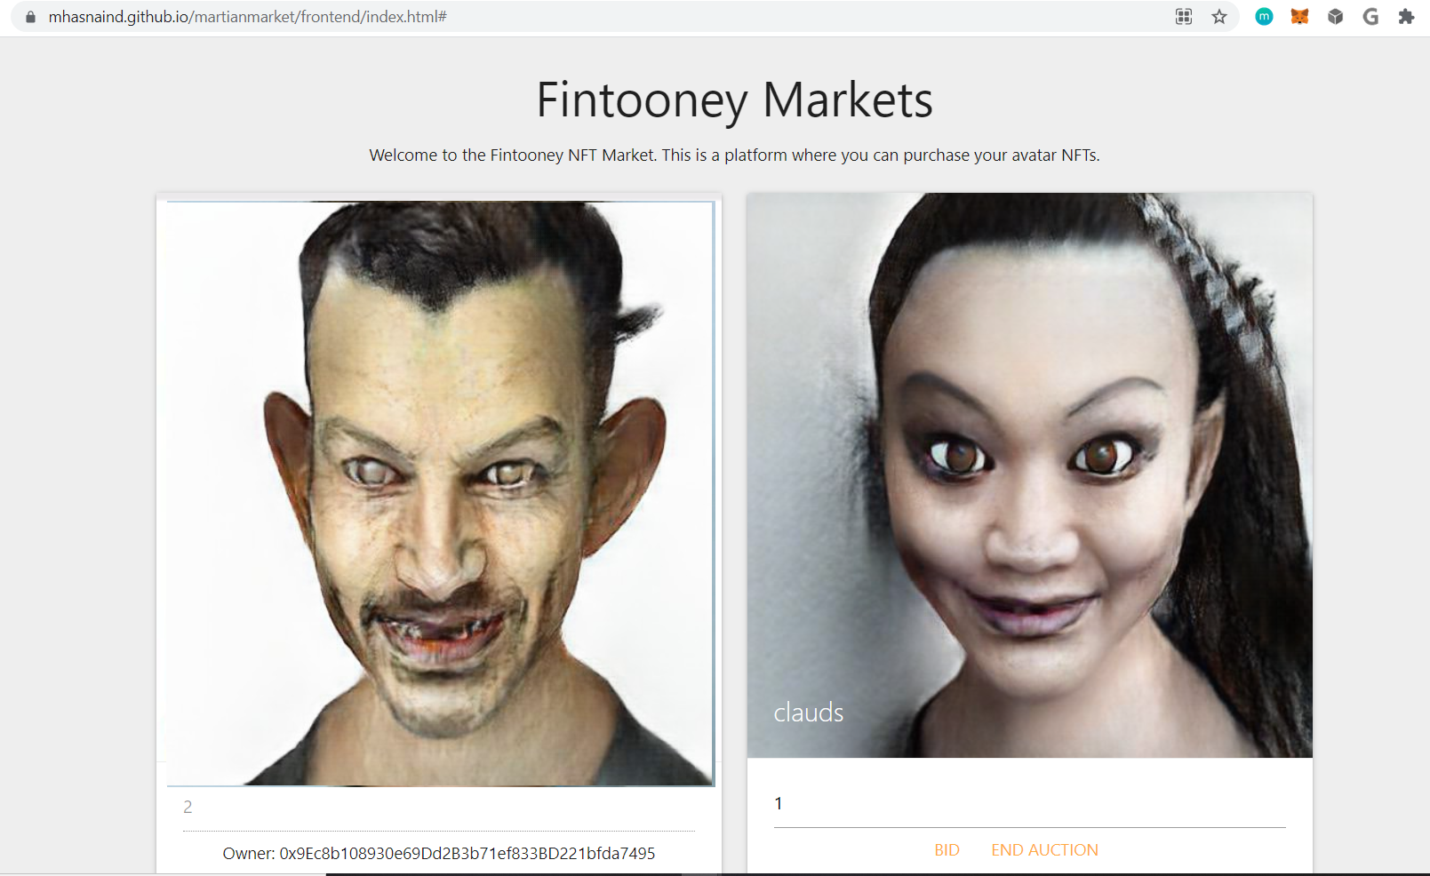
Utilising AI to alter images and create NFT Avatars
Toonify AI
IPFS Storage
Conversion of real images to selected toonify avatars
Decentralised storage via pinata to allow for URI connection in contracts and code
Notes:
So we can see the front end with Liam FinTooneyCoin and the owner hash down the bottom.
Claudia FinTooneyCoin is open to bidding.

Slide 16
Summary
01
AI powered technology to produce avatars, storage via IPFS
02
API and Python Integration to allow for rapid application scalability
03
Solidity smart contracts built on trusted Ethereum blockchain
Customised Experience
Ability to develop different avatars and mint as a personal NFT token
Notes:
16-17 summary and learning - Mo

Slide 17
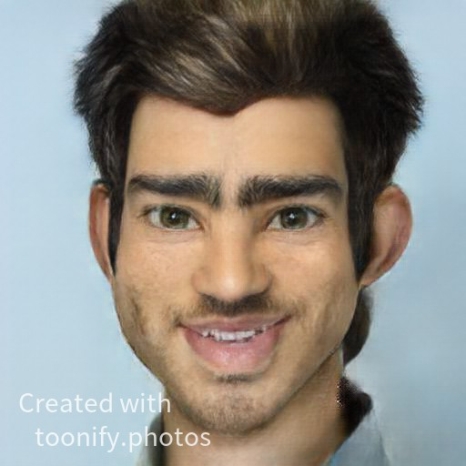
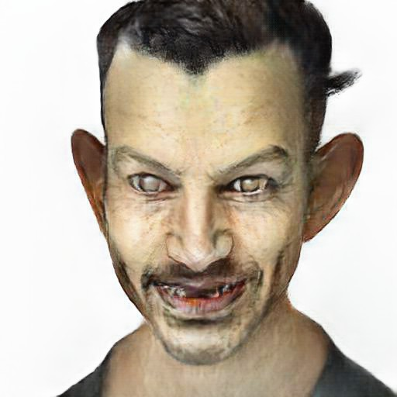
Key learnings
Connecting multiple contracts in solidity and understanding the code as well as avoiding duplication
API Integration, conversion of image in bytes to jpeg
Front end development issues
NFT’s generally sold using ETH by default, additional complexity to require purchase with token (FintooneyCoin)
NEXT STEPS
Build Fintooney - a love child between Etsy and Open Sea - A customisable NFT platform
Notes:
NFT’s generally sold using ETH by default, additional complexity to require purchase with token (FintooneyCoin)
Difficult to find out the balance of fintooney coins in their balance / bid issues - they could bid more or not - do they have different currencies / what if they had placed multiple bids and multiple NFTs / Do we link all NFTs together to find the balance / How do we locate fintooney in someones wallet when they have other currencies in their wallet /

Slide 18
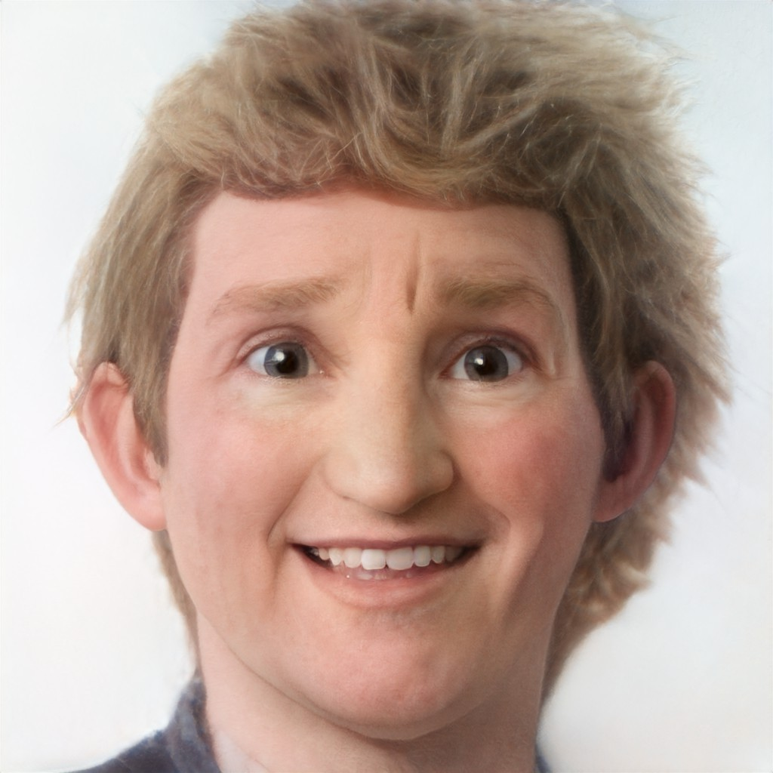
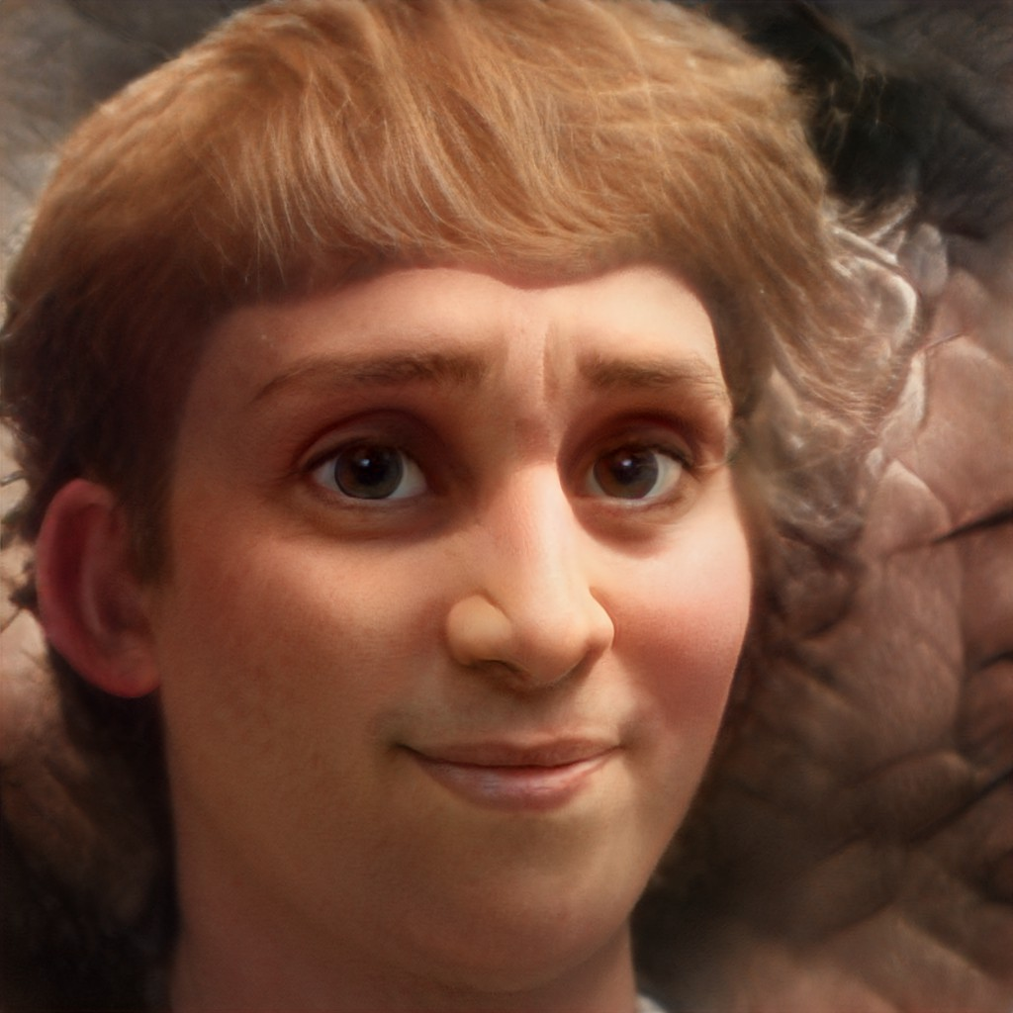
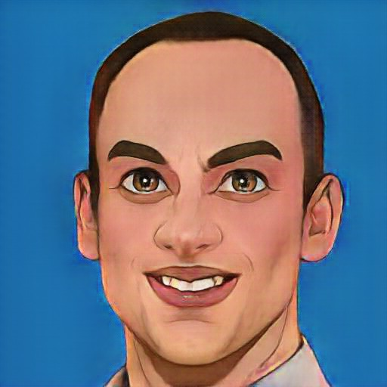
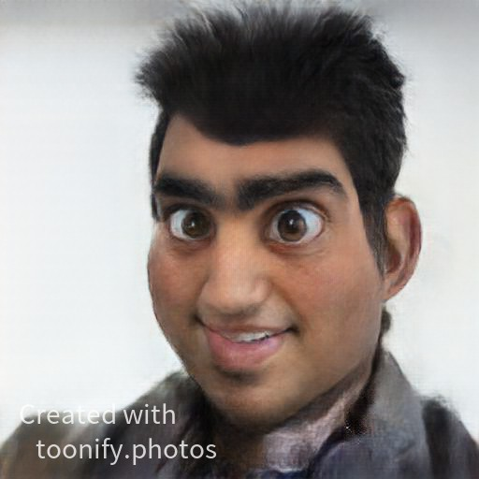
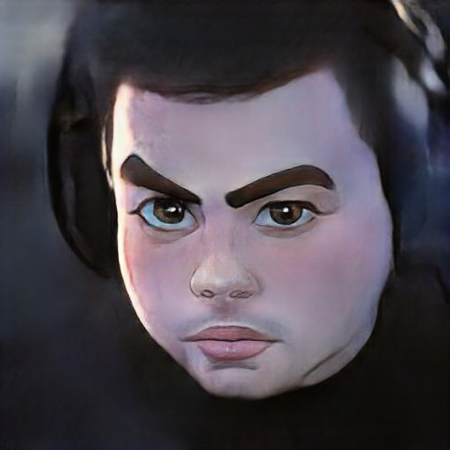
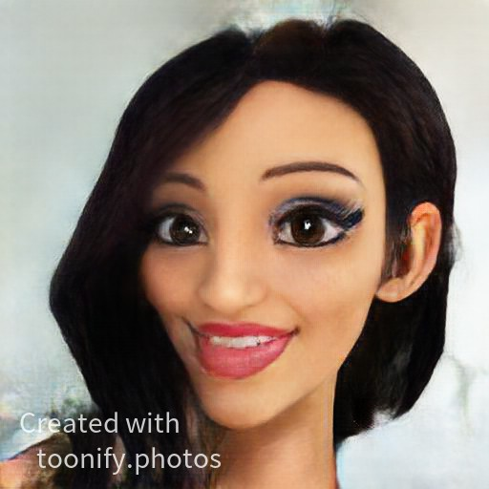
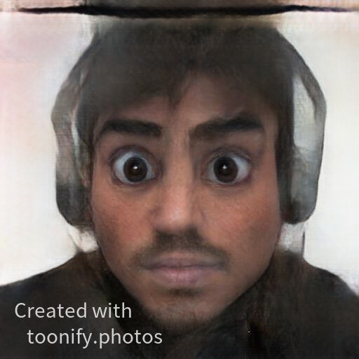
Do you recognise these faces?
Notes:
At the end of the bootcamp we took an after-shot

Slide 19
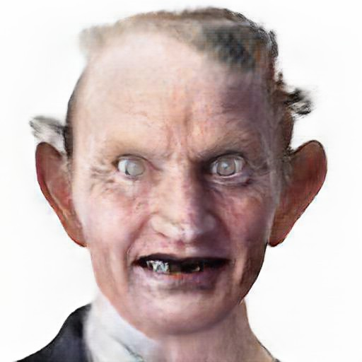
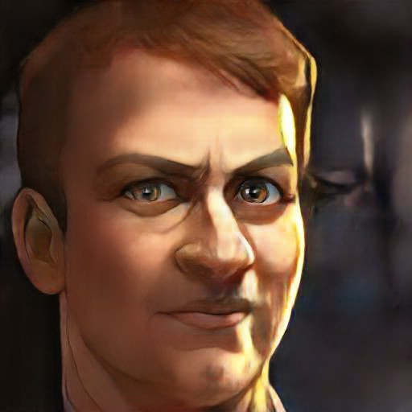
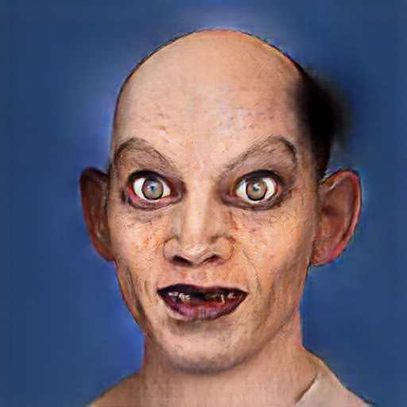
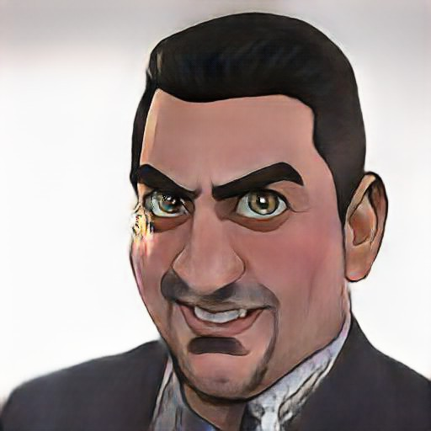
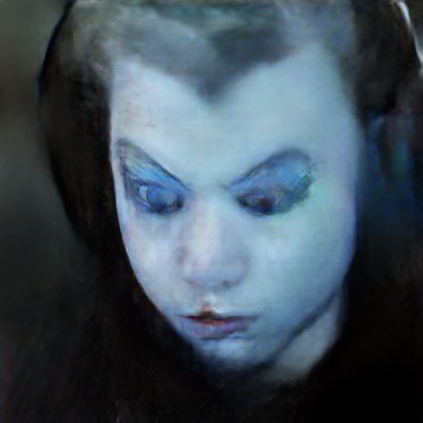
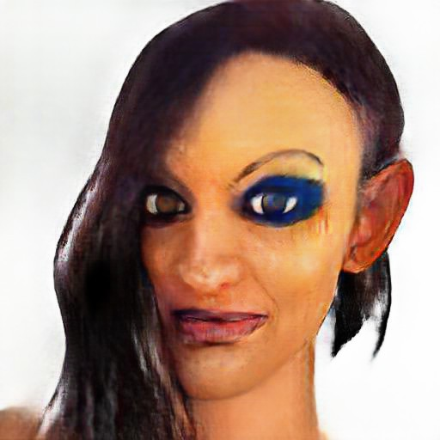
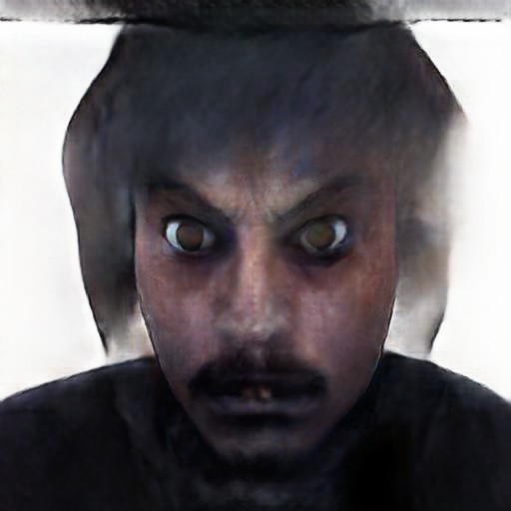
How about these guys?
Notes:
At the end of the bootcamp we took an after-shot

Slide 20
Questions?

